Slide 1
Lecture 4 advanced multipanel plots
Trevor A. Branch
FISH507H
School of Aquatic and Fishery Sciences, University of Washington
catalyst.uw.edu/workspace/tbranch/24589

Slide 2
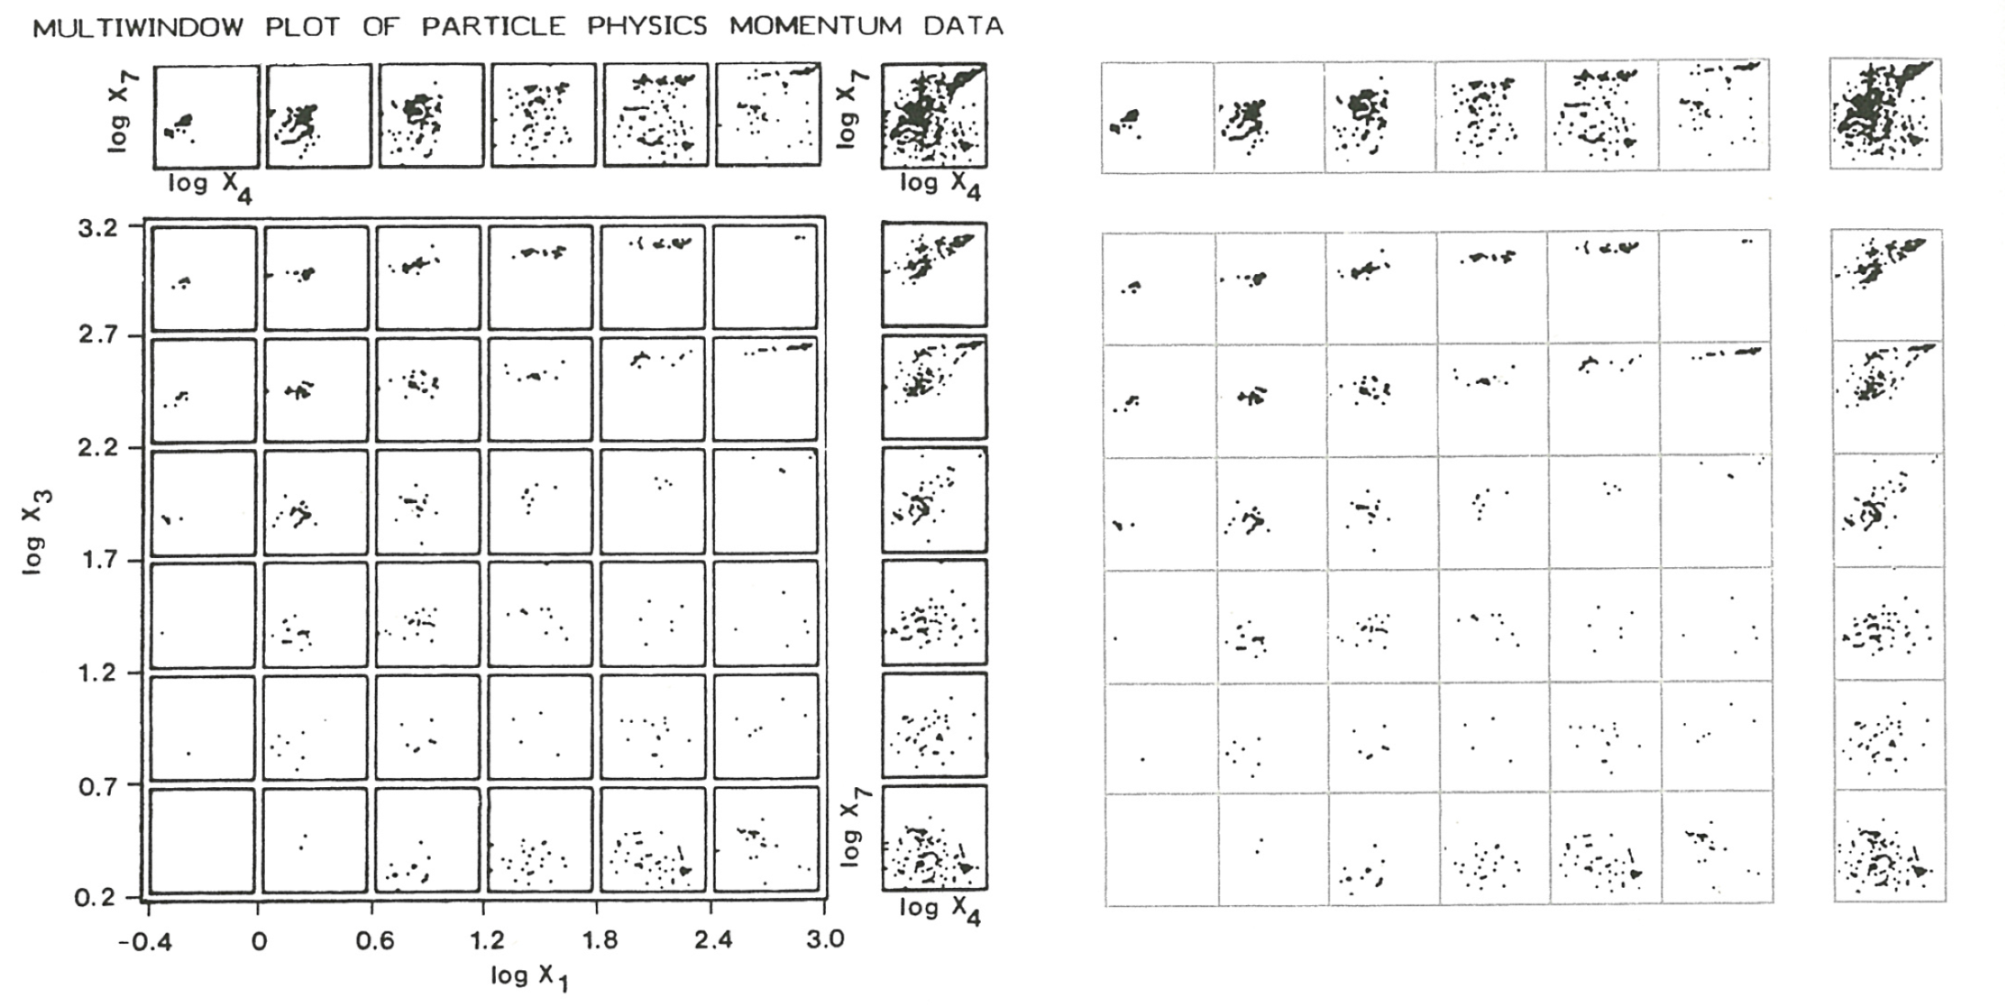
Tufte ER (2001) The visual display of quantitative information, p. 114

Slide 3
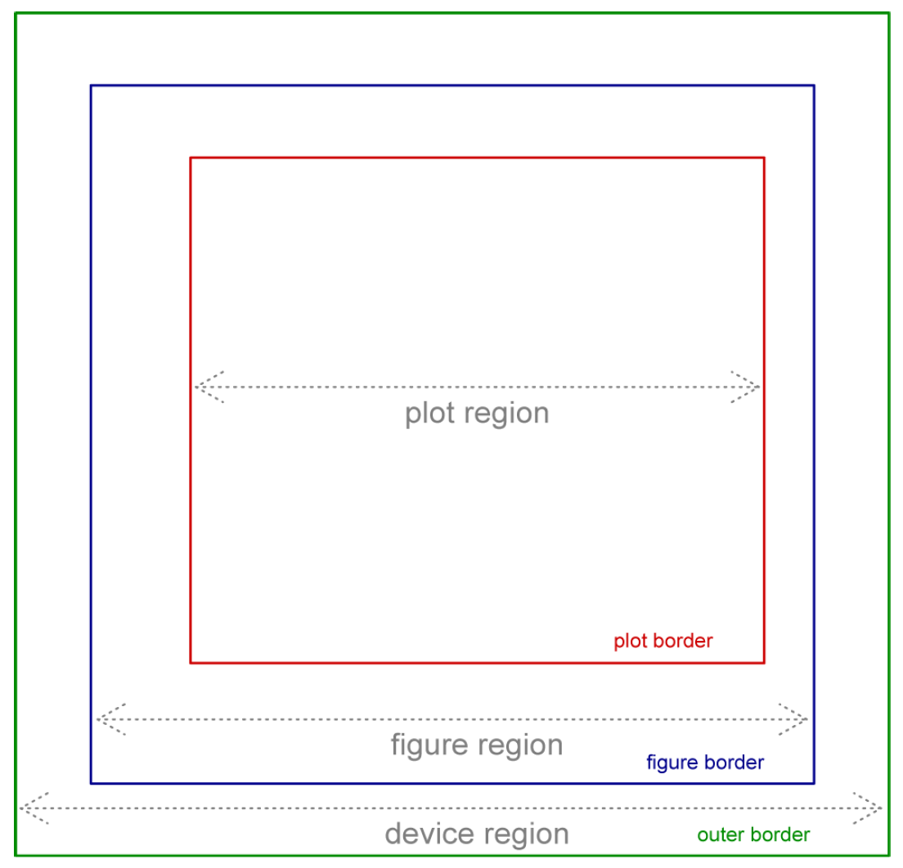
Source: Melissa Clarkson, http://students.washington.edu/mclarkso/

Slide 4
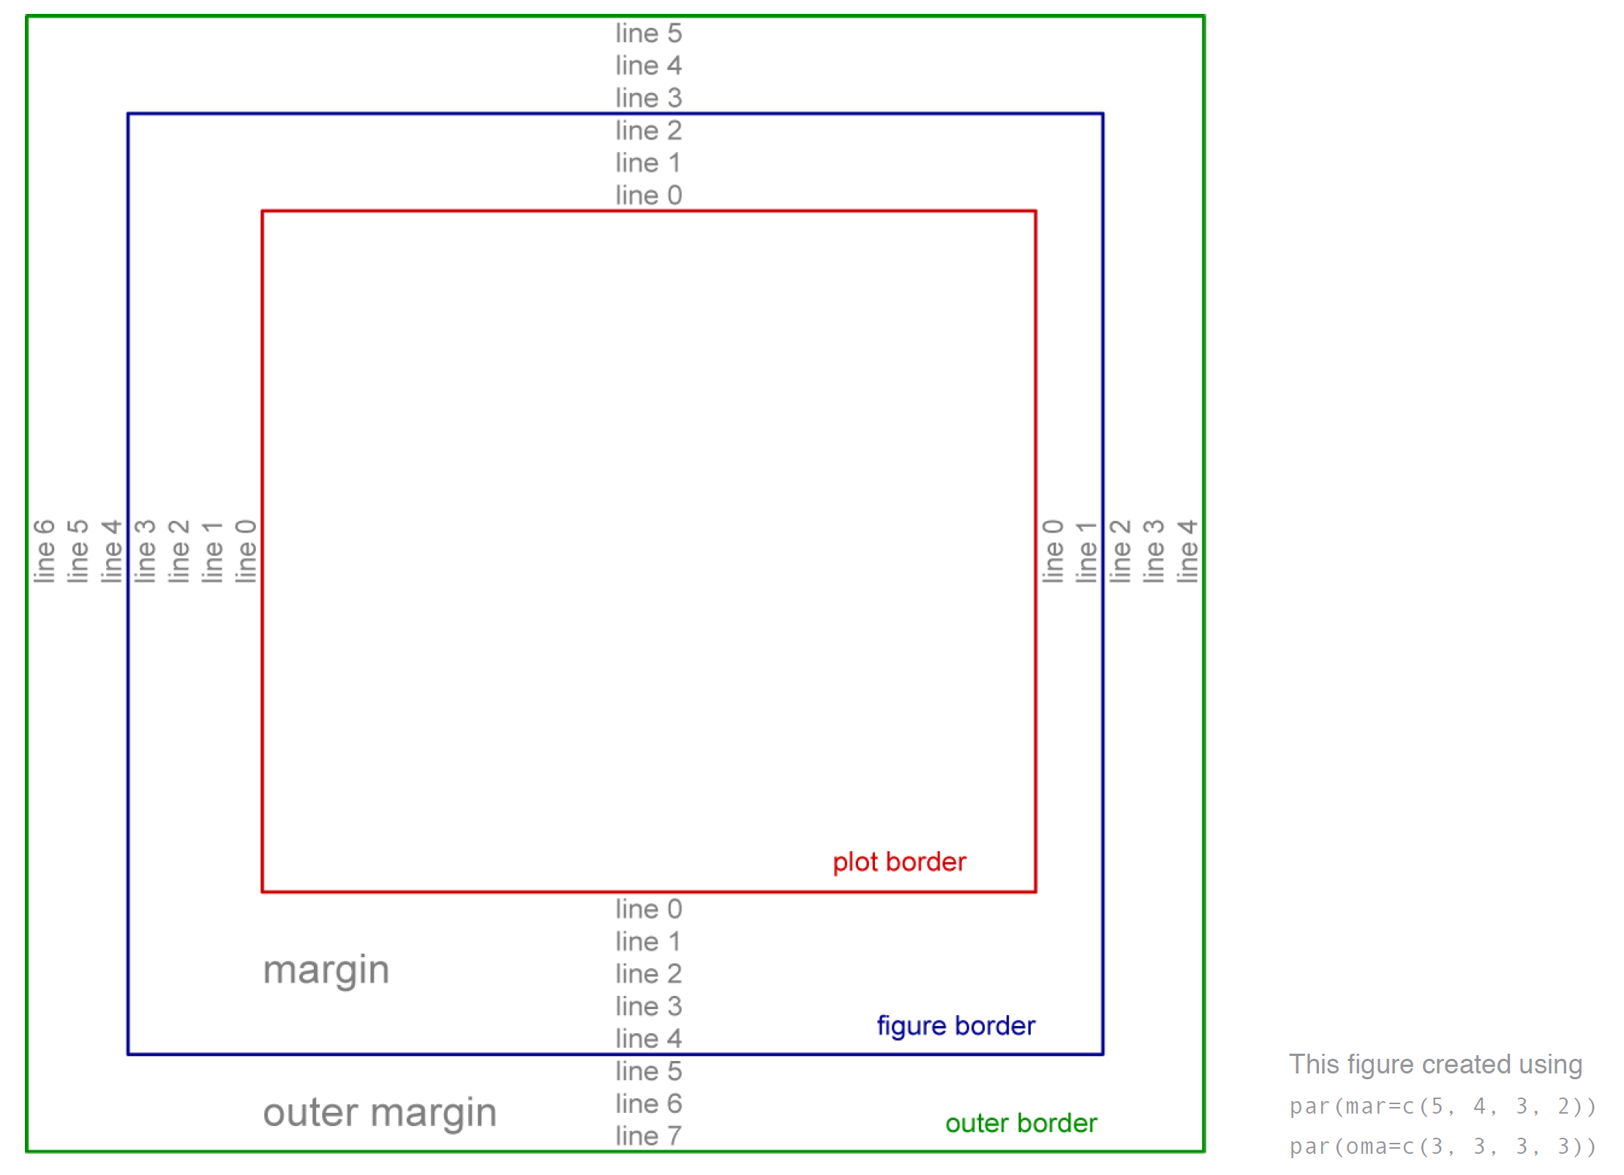
Source: Melissa Clarkson, http://students.washington.edu/mclarkso/

Slide 5
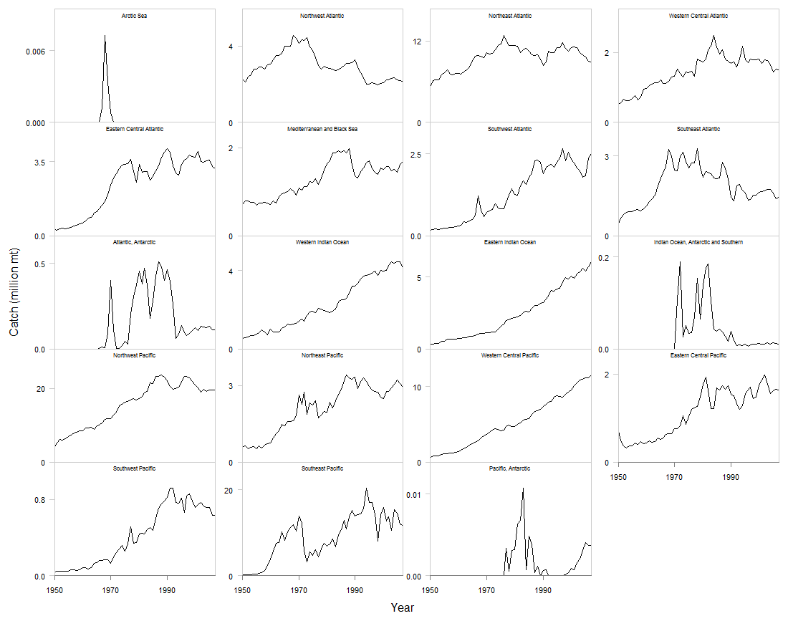

Slide 6
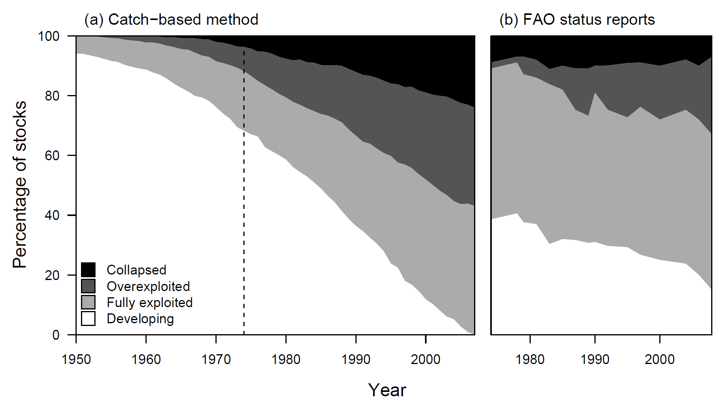
mat <- matrix(c(1,2), nrow=1, ncol=2)
layout(mat=mat, widths=c(56, 29))
Branch et al. (2011) Conservation Biology 25:777-786

Slide 7
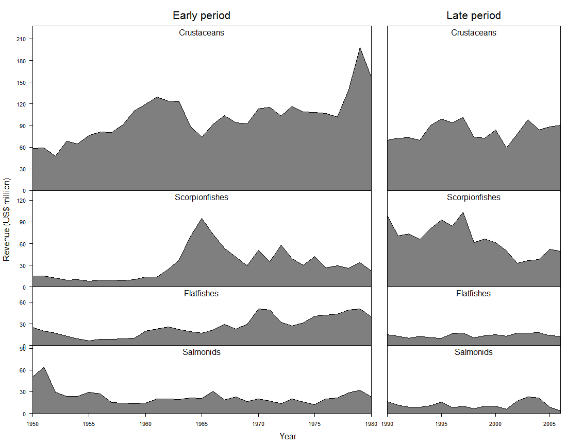
maxC <- apply(reven.data, MARGIN=2,max)
mat <- matrix(1:8,nrow=4,ncol=2, byrow=T)
par(mar=c(0,2.5,0,0), oma=c(5,2.5,4,1))
layout(mat=mat, widths=c(30,16),heights=30+maxC)

Slide 8
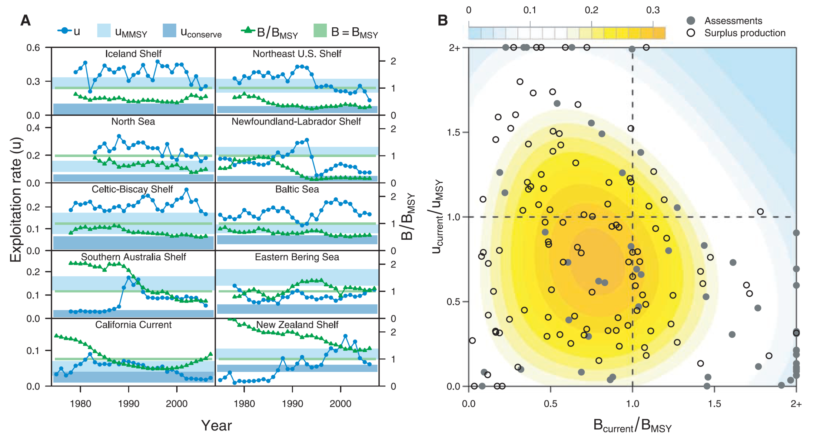
mat=matrix(c(1,2,3,4,5, 6,7,8,9,10, 0,0,0,0,0, 11,11,11,11,11),
nrow=5, ncol=4, byrow=F)
layout(mat=mat, heights=c(1,1,1,1,1), widths=c(5,5,3,10))
par(oma=c(5,5,1,1),mar=c(0,0,0,0))
Worm et al. (2009) Science 325:578-585

Slide 9
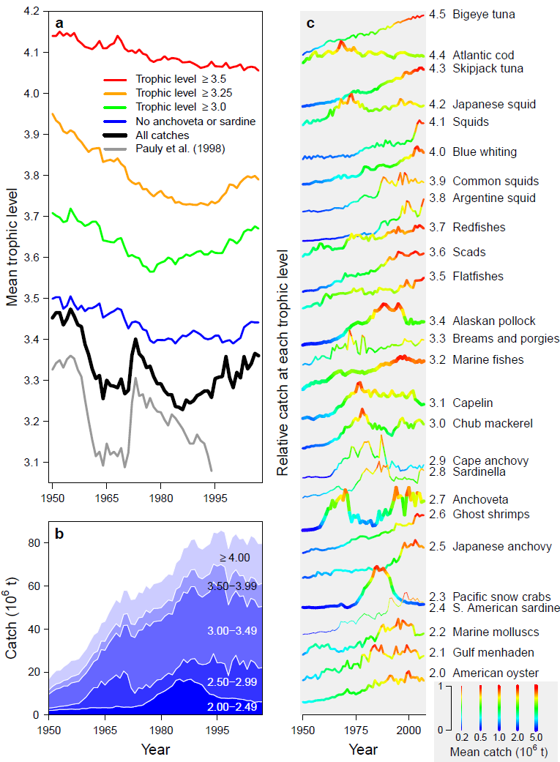
Main plot
mat <- matrix(c(1,2,3,3), nrow=2, ncol=2, byrow=F)
par(oma=c(1,2,1,11), mar=c(3,2,0,1))
layout(mat=mat, widths=c(2,1.3), heights=c(2.2,1))
Trickery for bottom-right “legend”
par(xpd=NA)
positions <- seq(from=2025,to=2060,length.out=5)
ypos <- c(-0.34,0.66)
#then commands for rect(), #arrows, axis(at=,pos=), #etc.
par(xpd=T)
Branch et al. (2010) Nature 468:431-435

Slide 10
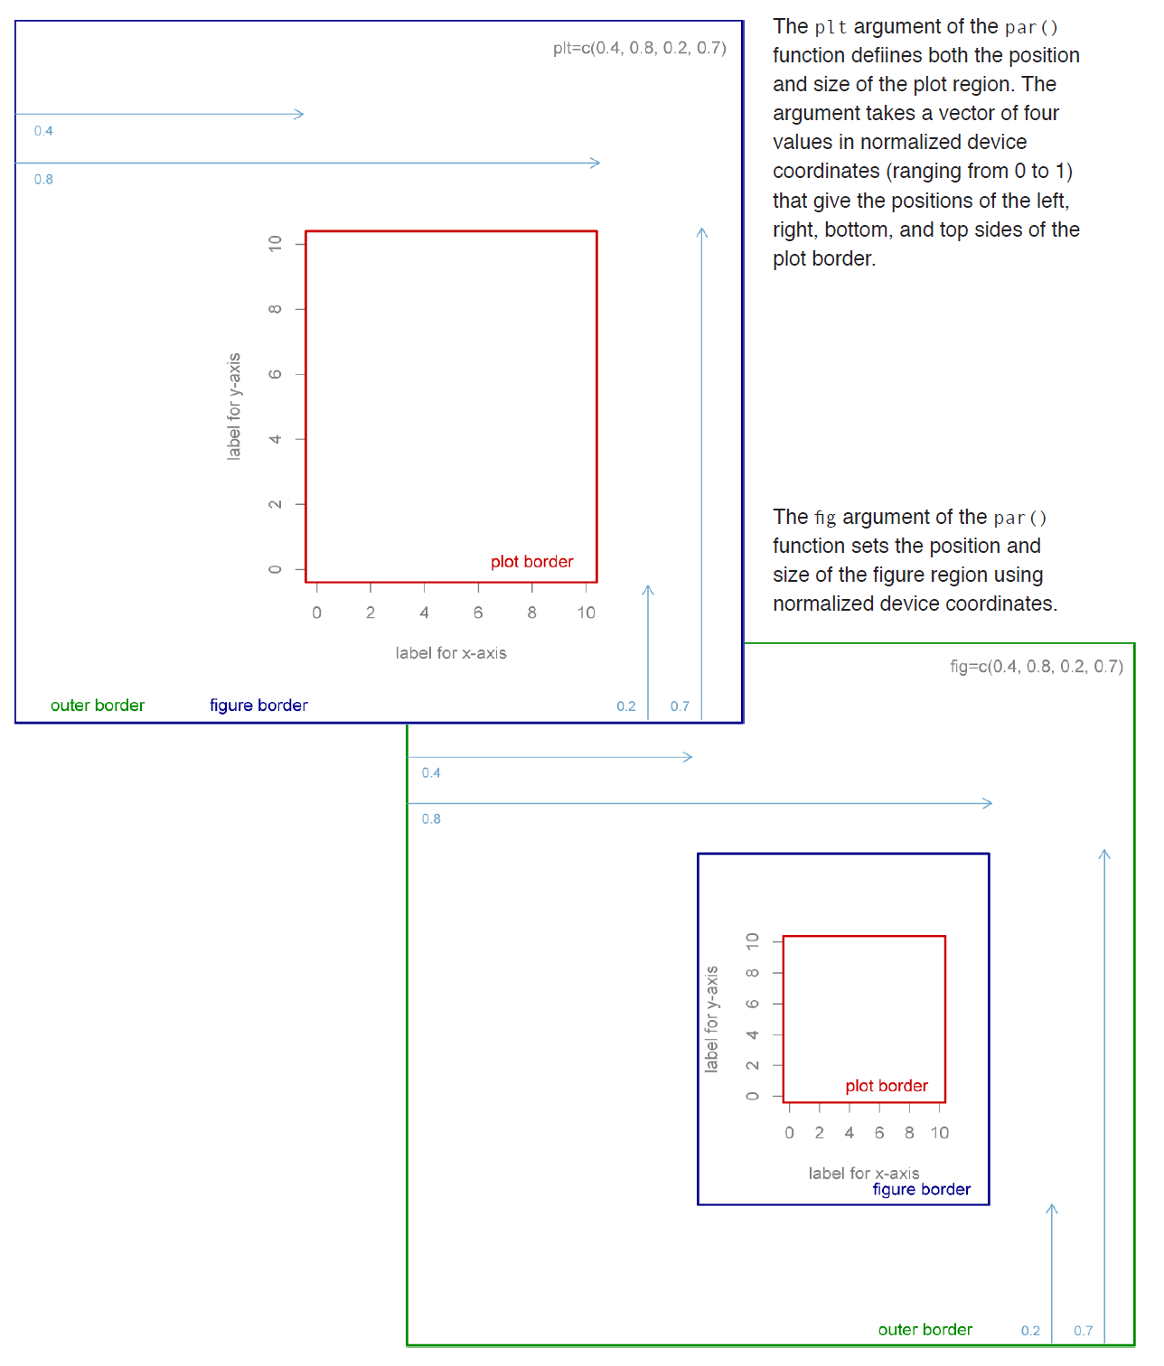
Figures at arbitrary (non-grid) locations using plt
par(plt=c(0.4, 0.8, 0.2, 0.7))
The plt() argument of the par() function defines the position and size of the plot region, as a vector of four values in normalized device coordinates (0 to 1) that give positions (left, right, bottom, top) of the plot border.
Source: Melissa Clarkson, http://students.washington.edu/mclarkso/

Slide 11

Figures at arbitrary (non-grid) locations using fig
par(fig=c(0.4, 0.8, 0.2, 0.7))
The fig() argument of the par() function defines the position and size of the device region, as a vector of four values in normalized device coordinates (0 to 1) that give positions (left, right, bottom, top) of the plot border.
Source: Melissa Clarkson, http://students.washington.edu/mclarkso/

Slide 12
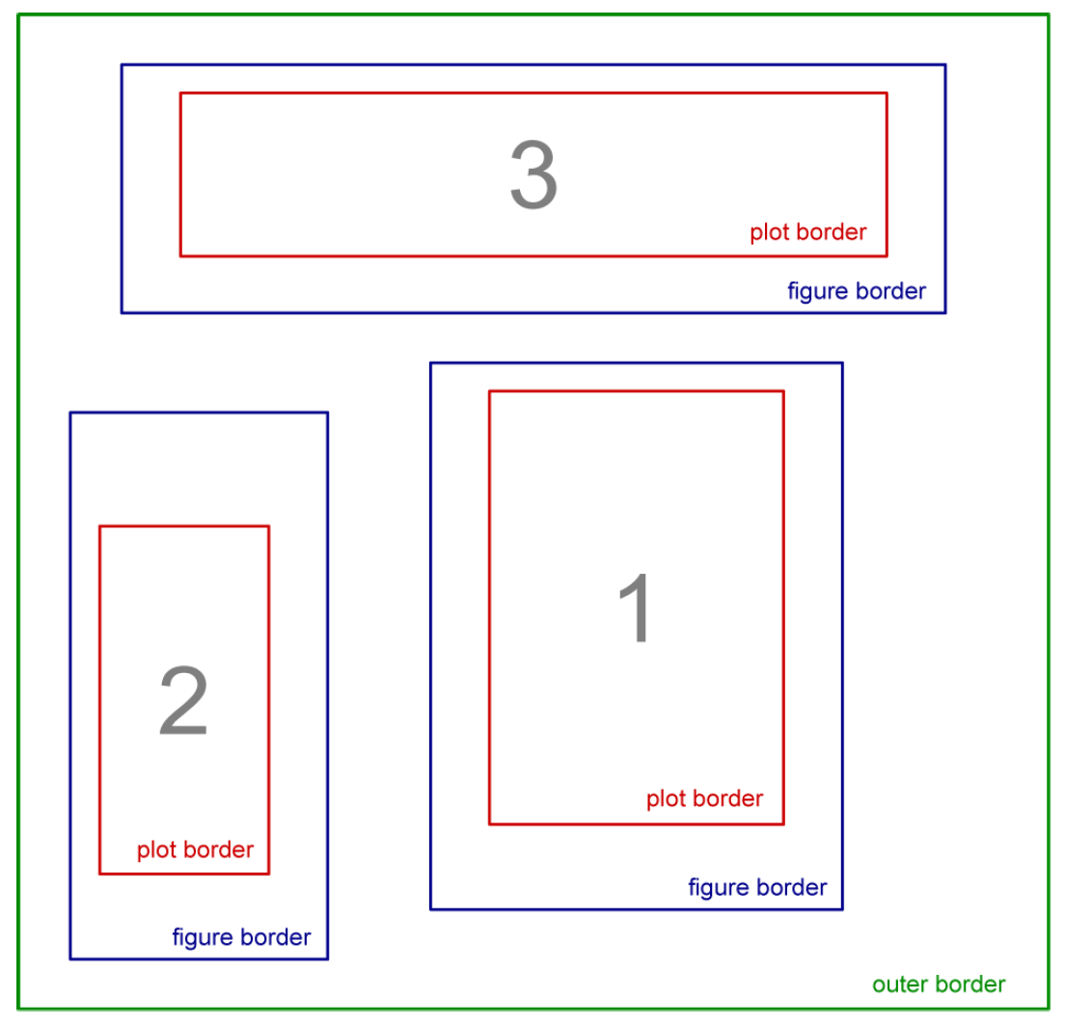
Figures at arbitrary (non-grid) locations using fig
Coordinates are given in normalized device space (from 0 to 1) and are specified by:
c(left, right, bottom, top)
i.e. a different order from par or oma
2. Plots can partially overlay other plots
3. Replacing fig= with plt= sets the plot border instead of the figure border
Source: Melissa Clarkson, http://students.washington.edu/mclarkso/

Slide 13
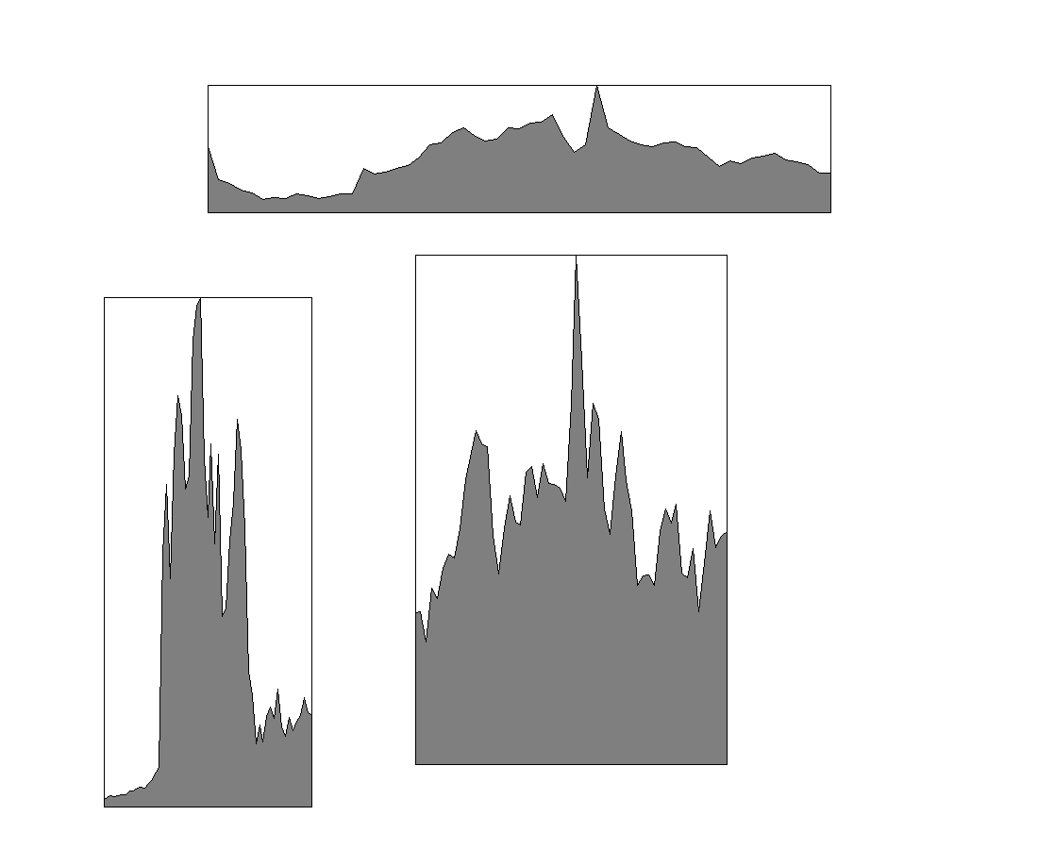
Figures at arbitrary (non-grid) locations using fig
par(fig=c(0.4,0.7,0.1,0.7))
plot(…)
par(new=T)
par(fig=c(0.1,0.3,0.05,0.65))
plot(…)
par(new=T)
par(fig=c(0.2,0.8,0.75,0.9))
plot(…)

Slide 14
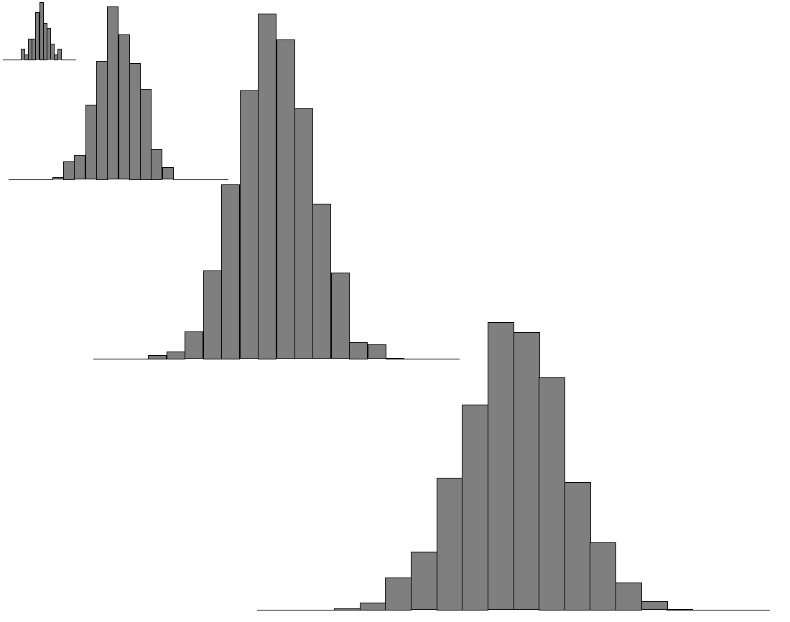
Figures at arbitrary locations using split.screen
mat <- matrix(c(0.0,0.1,0.9,1,
0.0,0.3,0.7,1,
0.1,0.6,0.4,1,
0.3,1.0,0.0,0.7), nrow=4,ncol=4,byrow=T)
par(mar=c(0,0,0,0), oma=c(1,1,1,1))
split.screen(figs=mat)
for (i in 1:4) {
screen(n=i, new=F)
plot(…)
}
close.screen(all.screens=T)

Slide 15
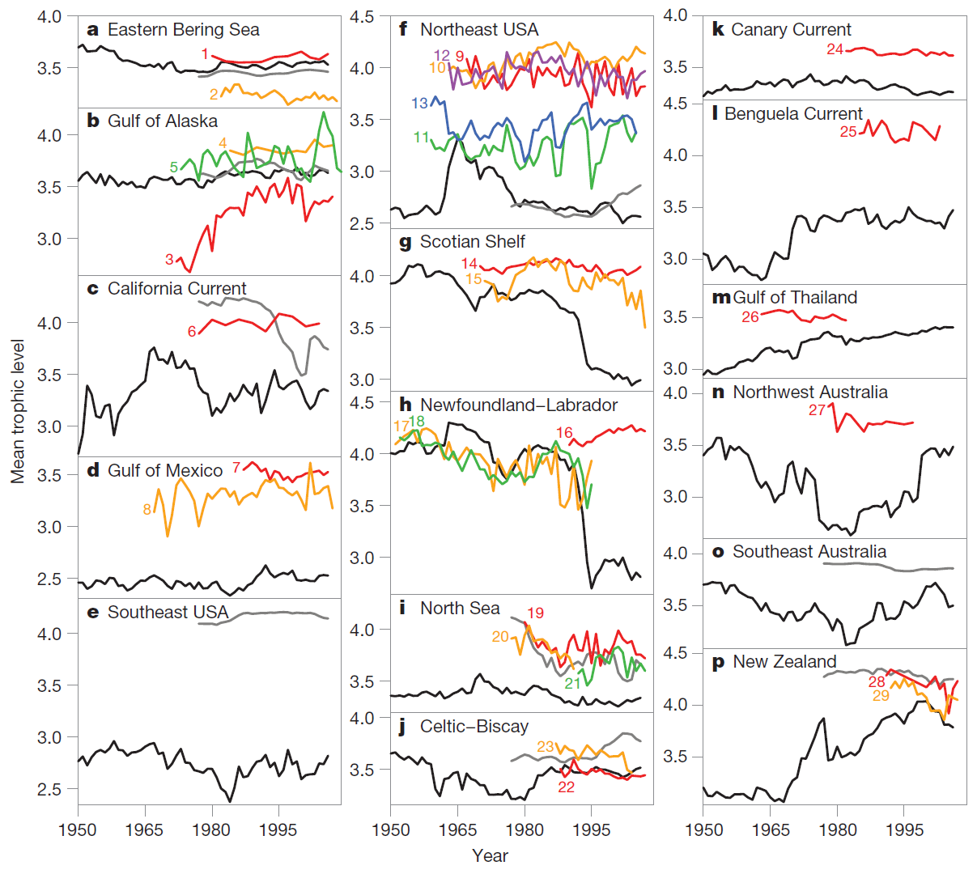
Branch et al. (2010) Nature 468:431-435

Slide 16
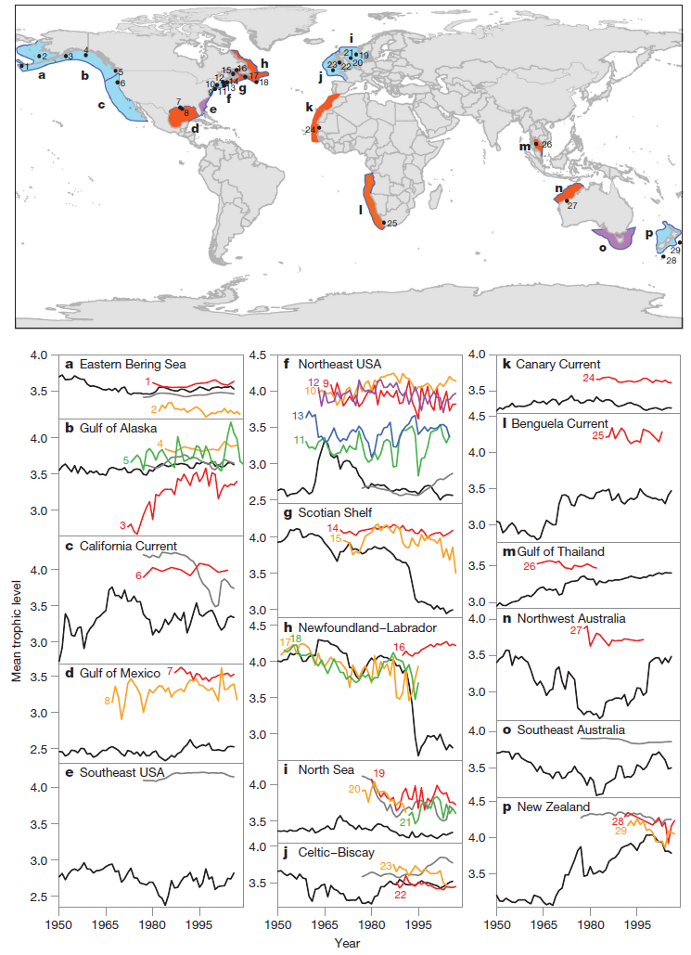
Branch et al. (2010) Nature 468:431-435

Slide 17
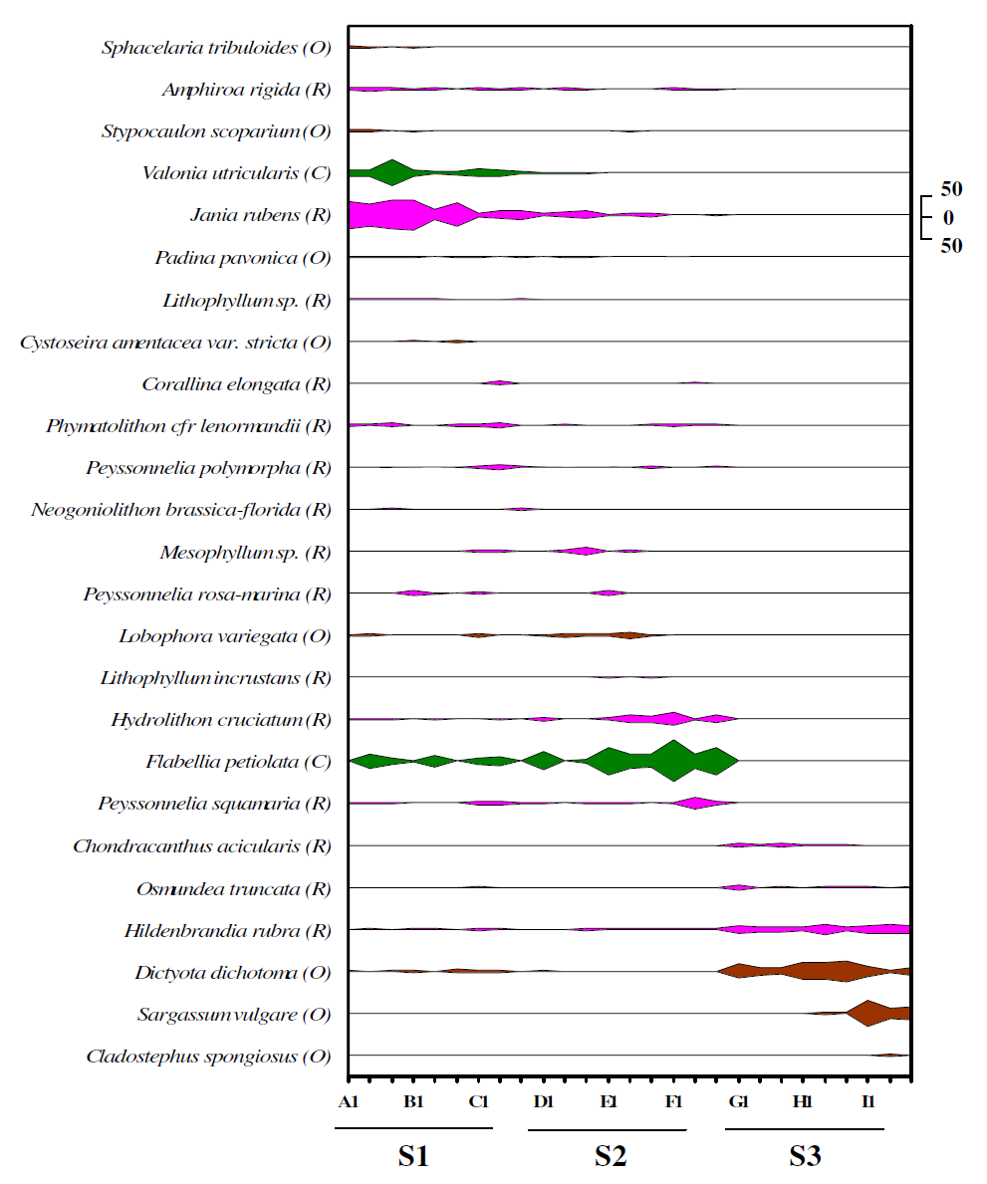
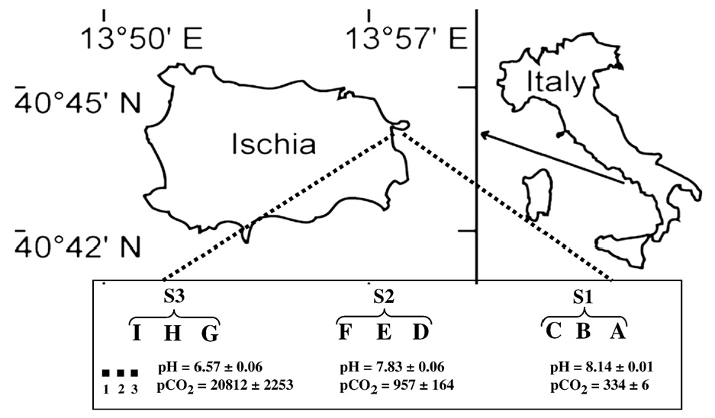
Class project: Figure 1
Fig. 2. Kite diagram showing the distribution of the most abundant macroalgal species (N3% coverage) in 27 20×20 cm quadrats taken along a pH gradient from S1 (pH=8.1), S2
(pH=7.8) and S3 (pH=6.7). R=Rhodophyta, O=Ochrophyta, and C=Chlorophyta.
Porzio L et al. (2011) Journal of Experimental Marine Biology and Ecology 400:278-287

Slide 18
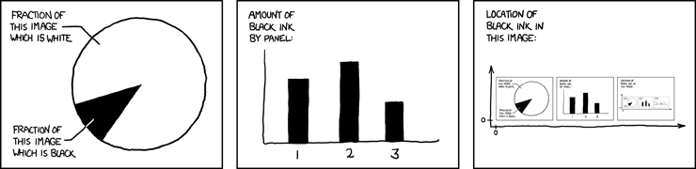
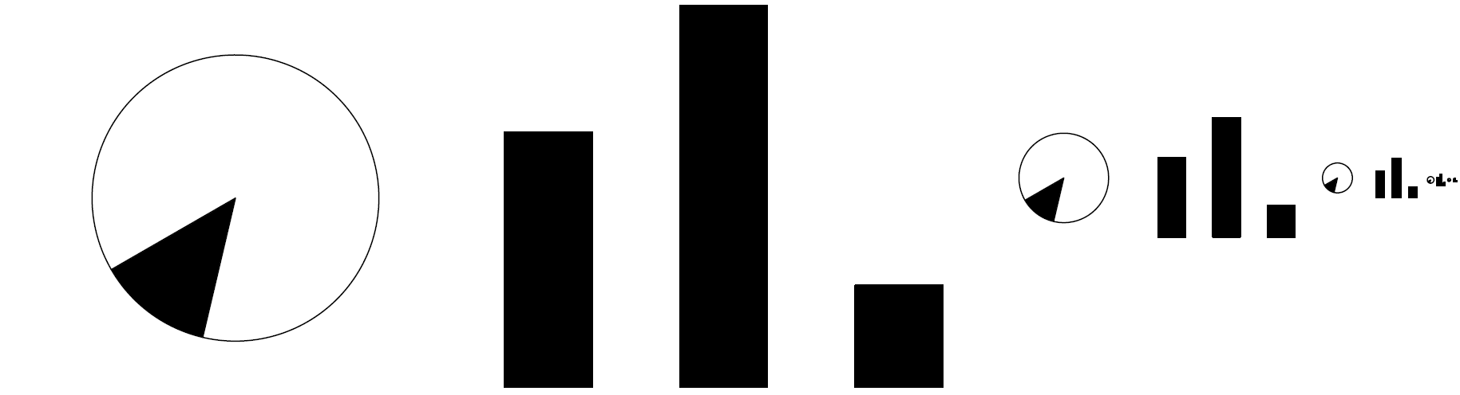
http://xkcd.com/688/
First attempt in R

